Slide 1
Energy-Harvesting Thermoelectric Sensing for Unobtrusive Water and Appliance Metering
Brad Campbell, Branden Ghena, and Prabal Dutta
2nd International Workshop on Energy Neutral Sensing Systems (ENSsys 2014) – November 6, 2014

Slide 2
The Call for “Low Power Sensors”
“BTO [Building Technologies Office] is particularly interested in innovative approaches that reduce the cost and power consumption for data collection of common building operation variables (temperature, pressure, relative humidity, etc.)…”
Source(s):
“Building Energy Efficiency Frontiers and Incubator Technologies (BENEFIT),” DE-FOA-0001027, 2014
Notes:
On Tuesday at SenSys we heard from Thyaga Nandagopal saying that NSF wants energy-harvesting continuous sensors. The Building Technologies Office agrees and calls for new approaches to low power building sensing systems

Slide 3
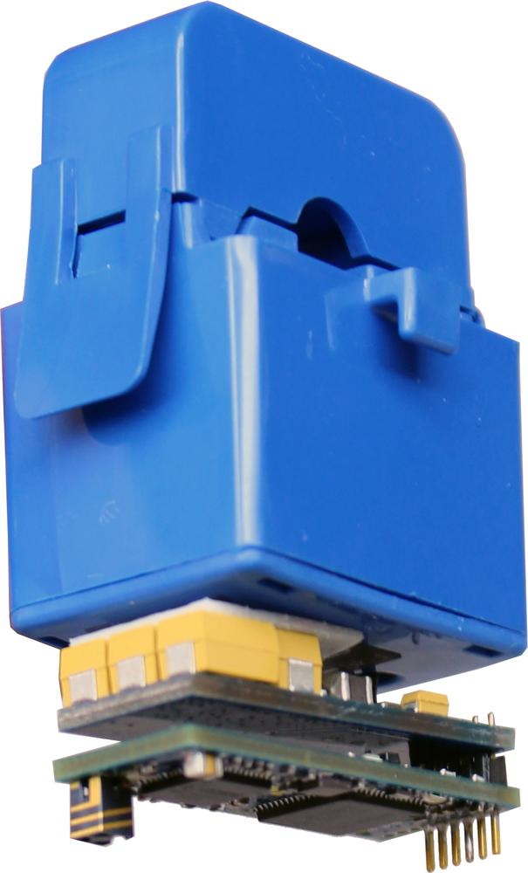
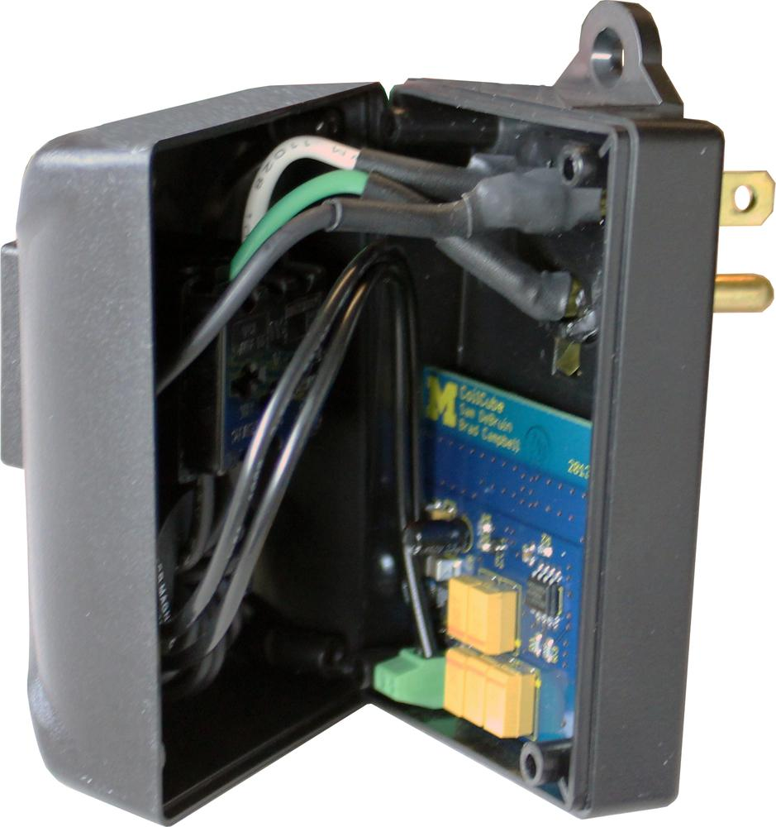
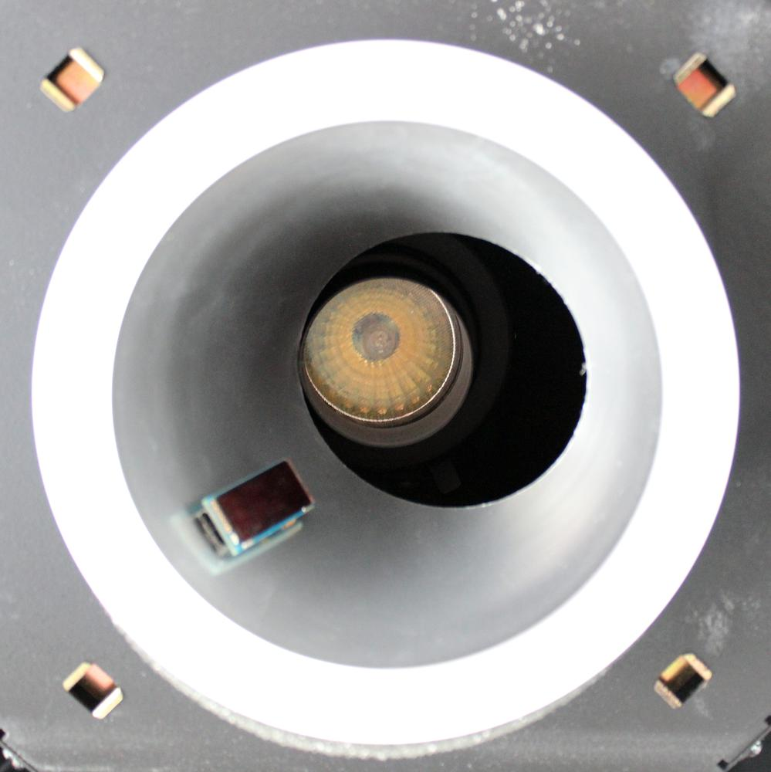
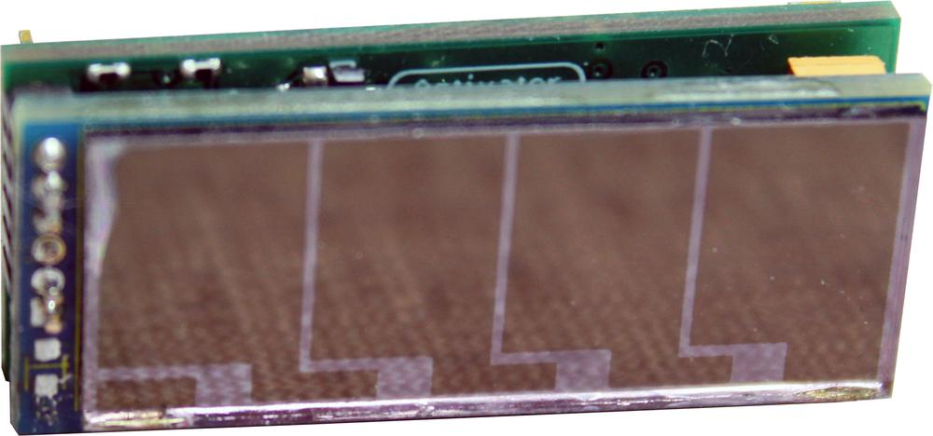
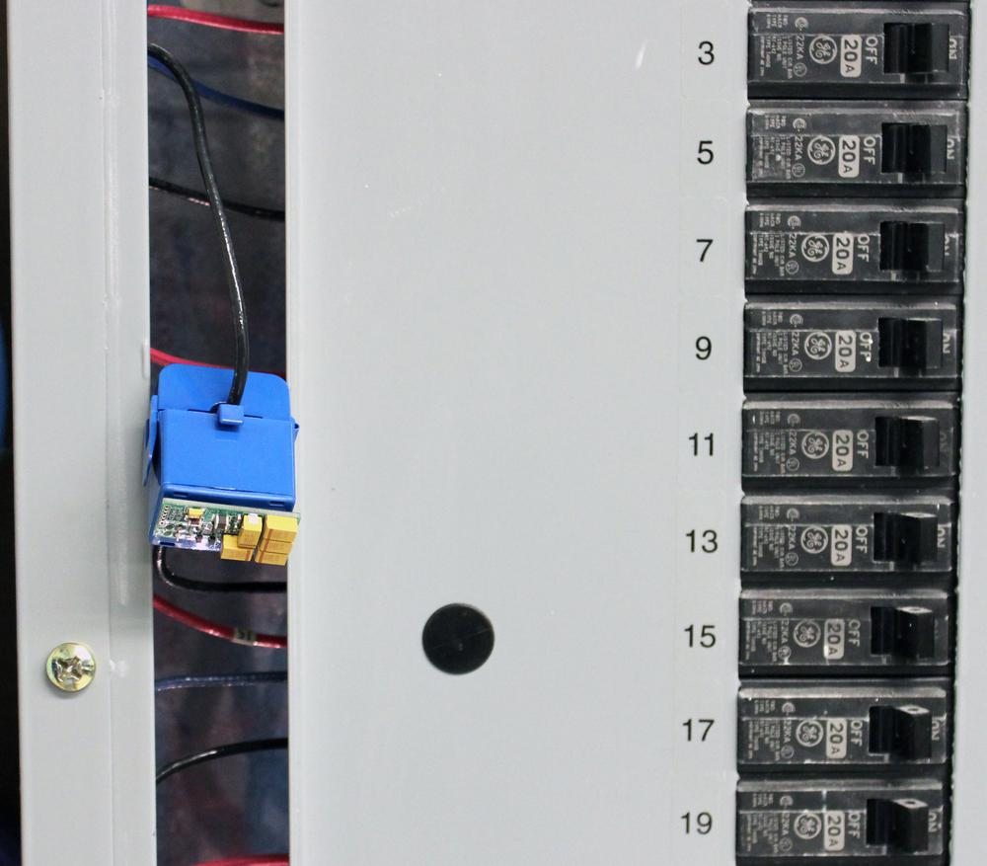
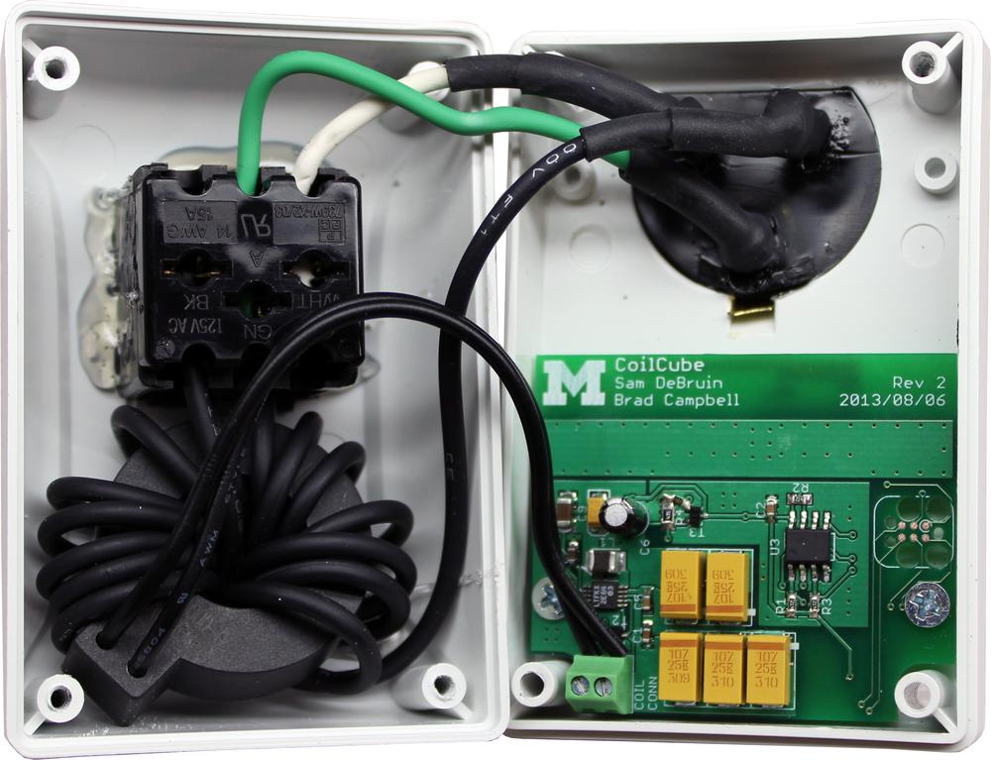
An Energy Harvesting Architecture
The Monjolo Family
Energy-neutral system
Wireless communications
Light-level
Plug-load
Panel-mount
Notes:
This is the Monjolo Principle

Slide 4
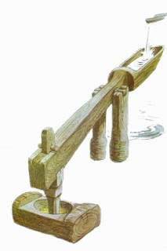
The Monjolo Principle
Monjolo: Portuguese water hammer
In an energy harvesting system:
The rate at which energy is harvested is proportional to the intensity of the measured phenomenon
The energy harvester is the sensor
Notes:
This is the Monjolo Principle

Slide 5
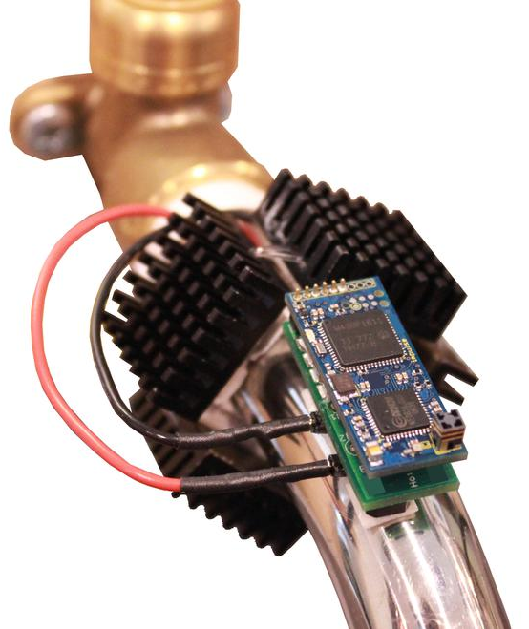
Our System Design
Thermes
Small form factor
Thermal energy-harvesting
Energy-neutral system
Wireless communication
Notes:
We do this by using a new system architecture for water metering devices.

Slide 6
Thermes System Architecture
Notes:
Digging into the architecture that enables Thermes,

Slide 7
Thermes System Architecture

Slide 8
Thermes System Architecture

Slide 9
Thermes System Architecture

Slide 10
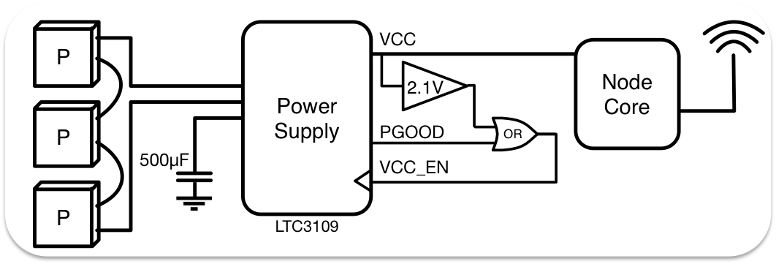
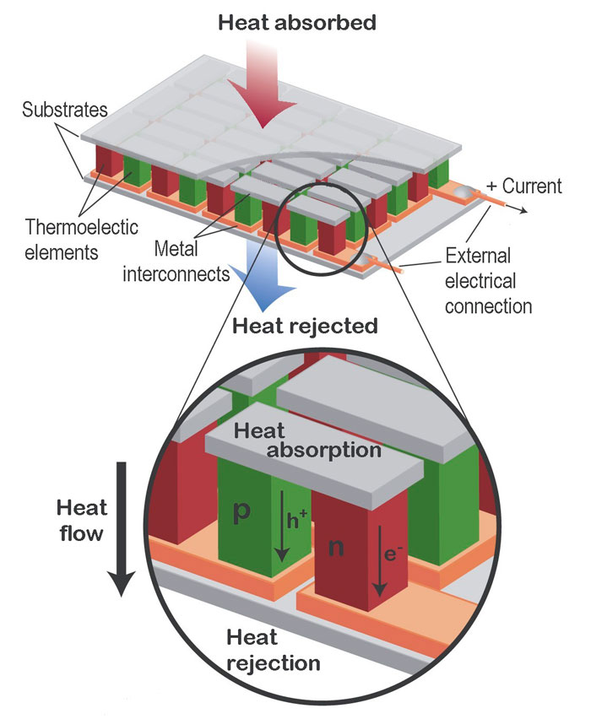
Harvesting Front End
Peltier junctions
Temperature differential into current
Low efficiency
Heat rejection is critical
Multiple junctions in series for more voltage
Notes:
Curiosity! And Voyager at 37 years…

Slide 11
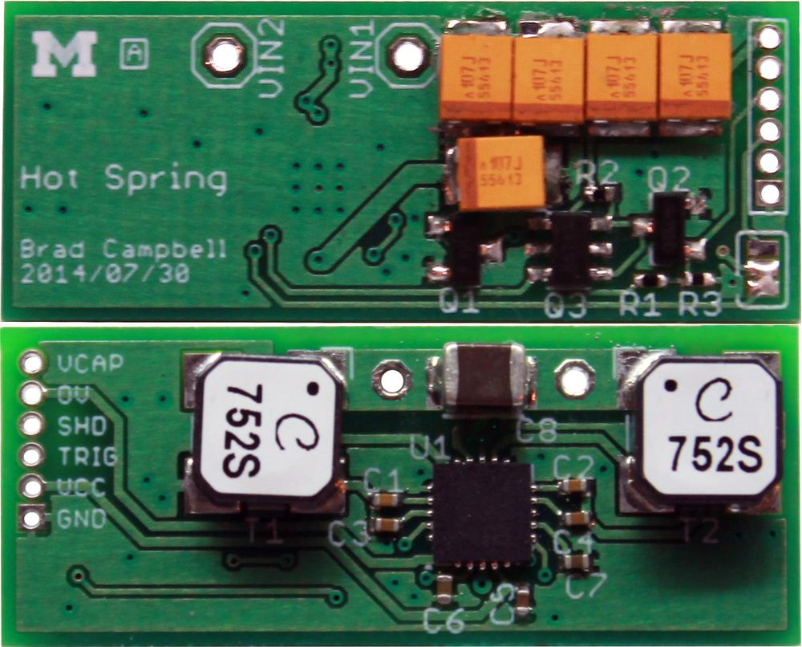
Zoom into Power System
Power supply
Auto-polarity
Harvesting begins at 30 mV
500 uF capacitor bank
No battery
Top
Bottom

Slide 12
Zoom into Latch Circuit
Latch sets size of “bucket” and turns the node core on and off
Turns on at 3.1 V, powers down at 2.1 V
Translates to 1.3 mJ per activation

Slide 13
Transmission Rate Changes with Temperature
Temperature Differential
Time
Radio Packet
Transmission
Time
Notes:
This means that an always-on receiver can receive these radio transmissions and use them to determine the temperature differential

Slide 14
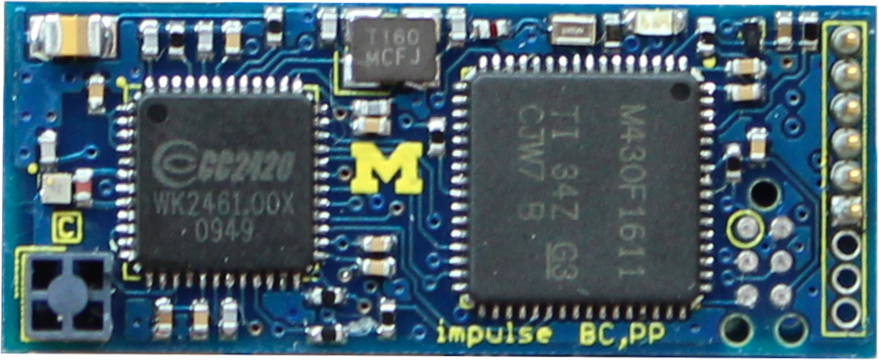
Zoom into Node Core
The classic node setup
MSP430
TinyOS
CC2420
802.15.4 communications
Top
Notes:
~Vintage~

Slide 15
Our System Design
Thermes
Energy-Neutral Thermal Sensing
But what can you do with such a sensor?
Notes:
We do this by using a new system architecture for water metering devices.

Slide 16
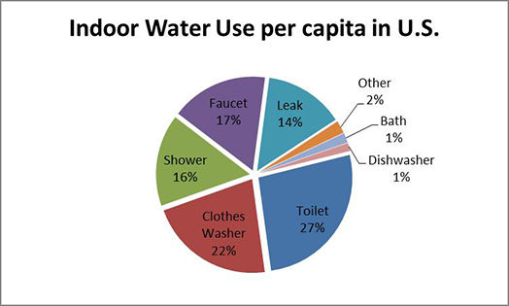
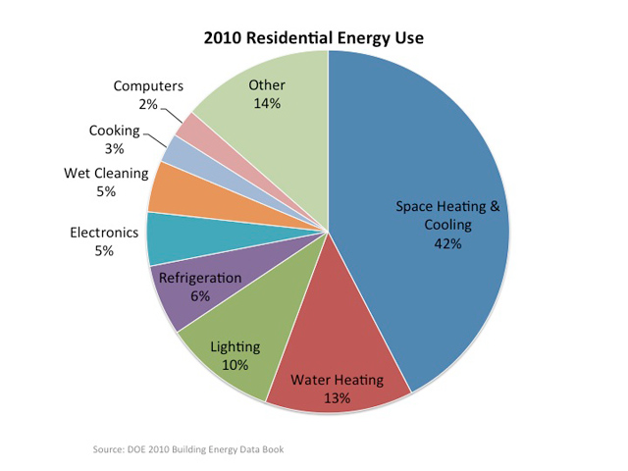
Shower Use Is a Contributing Factor
American Water Works Association Research Foundation, “Residential End Uses of Water.” 1999
Department of Energy, “Building Energy Data Book.” 2010
Consumers don’t have insight into how this energy is being spent

Slide 17
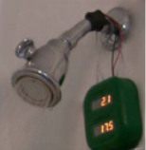
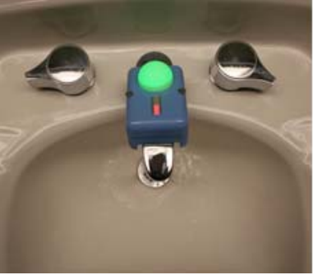
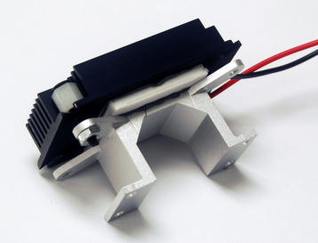
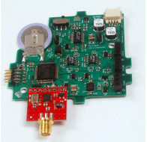
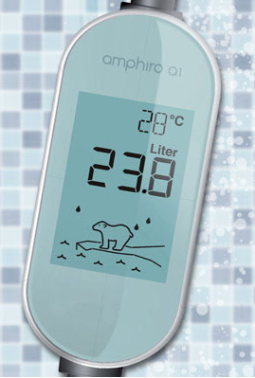
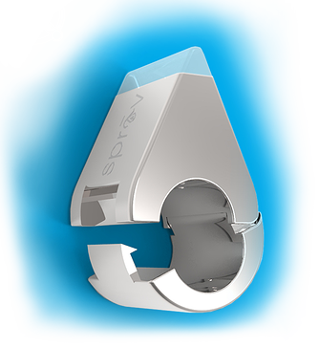
Existing Water Meters

Slide 18
Acoustic Water Meters
High powered sensing
Lifetime limitation
Upstream
Sprav
Notes:
These systems are very attractive because they simply clip (or wire) on to a pipe in order to measure water use. Both of these use microphones in order to determine when water is actually running and augment that information with temperature sensors.
The downside here is battery life. The test deployment of Upstream was severely limited by battery life and nodes could only be deployed for 4-7 days without attention.
There are also problems with these devices of limited communications. Sprav attempts to communicate data, but uses Bluetooth to talk to Smartphones. This just doesn’t seem like a great choice to me. I know people take their phones into the bathroom, but into the shower is really one step too far for me…

Slide 19
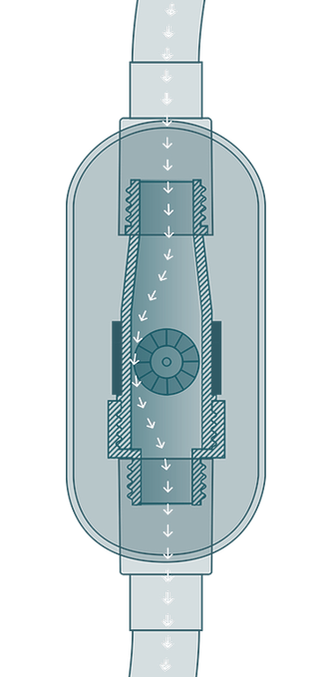
Impeller-Based Water Meters
Amphiro
Impeller-based design
Good for energy harvesting
Difficult installation

Slide 20
Thermal Harvesting Water Meters
Thermoelectric energy-harvesting
Energy-neutral in some cases
Accelerometer-based sensing
Increases energy needs
DoubleDip

Slide 21
Applying Our Solution
This is an area for which we designed Thermes
Trade accuracy and fine-grained detail for continuous batteryless operation
Shower sensing is actually very challenging for this system

Slide 22
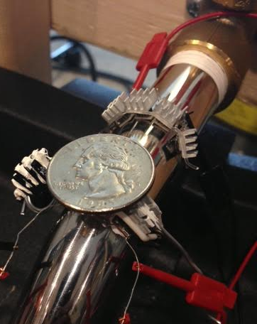
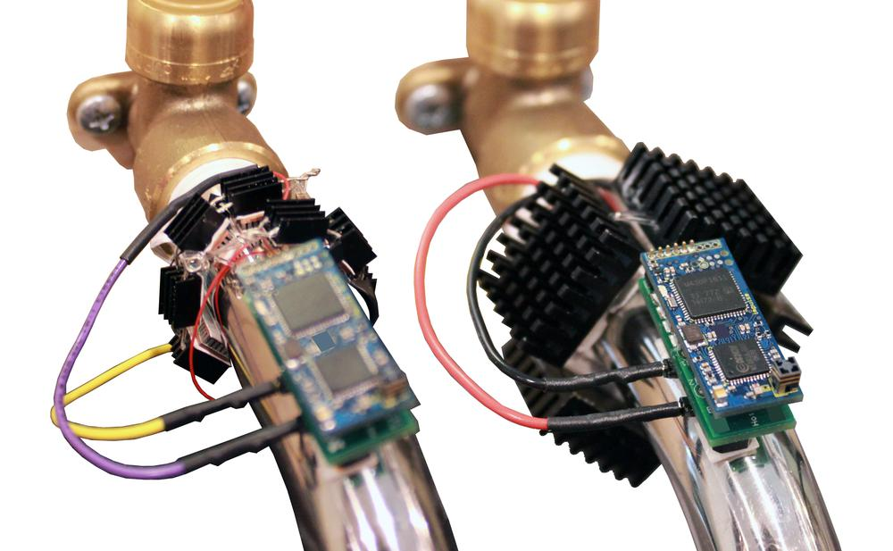
Thermes Implementations
Small Bracelet
6 Peltier Junctions (7 mm x 6 mm)
9 Heatsinks
Large Bracelet
4 Peltier Junctions (15 mm x 15 mm)
4 Heatsinks

Slide 23
Evaluation Criteria
How does it work at various water temperatures?
How well can it estimate start and stop times?
How well does it work on a real shower?
What other applications can it be used for?

Slide 24
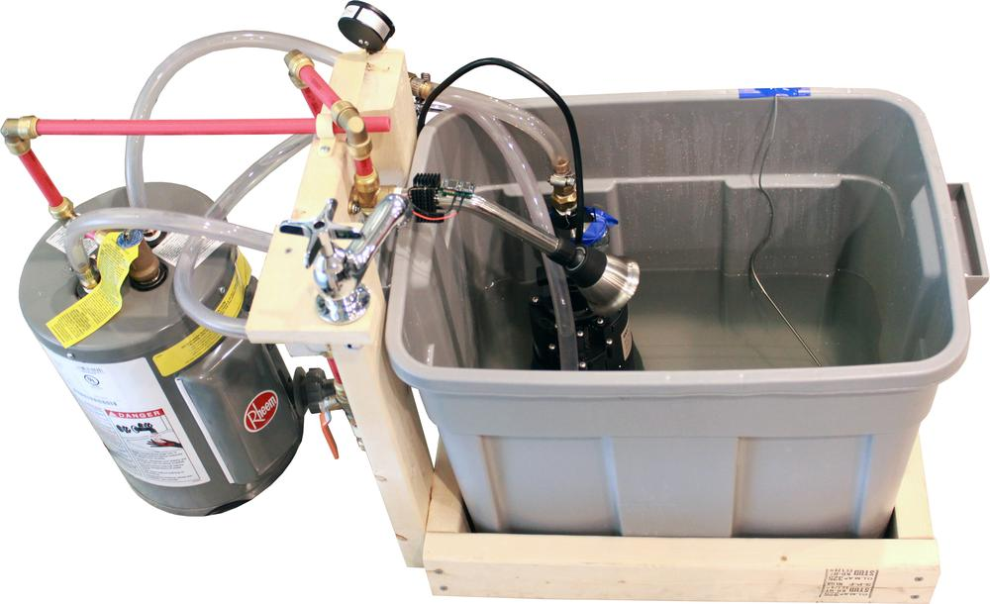
Evaluation Setup
Mini-shower
Allows for configurable constant water temperature
Ambient temperature remained 23° C for all tests

Slide 25
Evaluation Setup
Thermes
Mini-shower
Allows for configurable constant water temperature
Ambient temperature remained 23° C for all tests

Slide 26
Evaluation Criteria
How does it work at various water temperatures?
How well can it estimate start and stop times?
How well does it work on a real shower?
What other applications can it be used for?

Slide 27
Operation at Average Shower Temperature
Shower On
Shower Off
Small Bracelet
Large Bracelet

Slide 28
Operation at Average Shower Temperature
Shower On
Shower Off
Small Bracelet
Large Bracelet

Slide 29
Operation at Average Shower Temperature
Shower On
Shower Off
Small Bracelet
Large Bracelet

Slide 30
Operation at Average Shower Temperature
Shower On
Shower Off
Small Bracelet
Large Bracelet

Slide 31
Equilibrium of the System
Temperature of Pipe
Time
Radio Packet
Transmission
Time
Notes:
This means that an always-on receiver can receive these radio transmissions

Slide 32
Equilibrium of the System
Temperature of Pipe
Time
Radio Packet
Transmission
Time
Notes:
This means that an always-on receiver can receive these radio transmissions

Slide 33
Lower Temperature Operation Is Troublesome
Shower On
Shower Off
Small Bracelet
Large Bracelet

Slide 34
Lower Temperature Operation Is Troublesome
Shower On
Shower Off
Small Bracelet
Large Bracelet

Slide 35
Evaluation Criteria
How does it work at various water temperatures?
How well can it estimate start and stop times?
How well does it work on a real shower?
What other applications can it be used for?

Slide 36
Estimating Start and Stop Times
Small Bracelet
Notes:
Activation rate changes even though temperature remains the same
This means extra processing is needed to know when the shower started and stopped

Slide 37
Estimating Start and Stop Times
Determine likely delay before first packet based on initial packet rate
Small Bracelet

Slide 38
Estimating Start and Stop Times
Look for change in steady state operation
Small Bracelet

Slide 39
Estimation Example
Test Results
3 second error on Start Time
9 second error on Stop Time
Small Bracelet

Slide 40
Evaluation Criteria
How does it work at various water temperatures?
How well can it estimate start and stop times?
How well does it work on a real shower?
What other applications can it be used for?

Slide 41
Real Showers
Shower started at time zero and continued for over ten minutes
Small Bracelet
Notes:
It took me a day to understand what was going on here.
The temperature of the shower in a large apartment building is less a function of the setting of the handle, and more of a group consensus problem. This occurred to me the next day while standing in the shower. As it suddenly became scaldingly hot.

Slide 42
Real Showers
Small Bracelet

Slide 43
Real Showers
Small Bracelet
Notes:
It took me a day to understand what was going on here.
The temperature of the shower in a large apartment building is less a function of the setting of the handle, and more of a group consensus problem. This occurred to me the next day while standing in the shower. As it suddenly became scaldingly hot.

Slide 44
Real Showers
Small Bracelet

Slide 45
Evaluation Criteria
How does it work at various water temperatures?
How well can it estimate start and stop times?
How well does it work on a real shower?
What other applications can it be used for?

Slide 46
Extending the Idea
Thermes can be used anywhere a temperature differential exists

Slide 47
Future Work
Better heat rejection
Improved mechanical design is necessary
Cost of device
Small form factor Peltier Junctions are expensive
Long-term deployment
What kind of data can we gain from continuous data collection?

Slide 48
Conclusion
Thermes
Energy-neutral thermal sensing
Reductionist Sensing
A new tool for ubiquitous and continuous sensing

Slide 49
Questions?
Energy-Harvesting Thermoelectric Sensing for Unobtrusive Water and Appliance Metering
Brad Campbell | bradjc@umich.edu
Branden Ghena | brghena@umich.edu
Prabal Dutta | prabal@eecs.umich.edu
http://github.com/lab11/monjolo
Notes:
Thank you very much

Slide 50
Bonus Slides

Slide 51
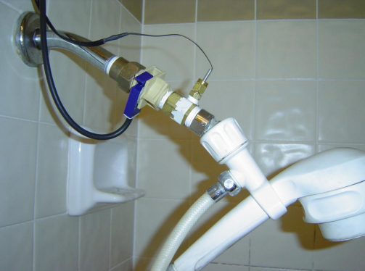
Wired Water Meters

Slide 52
View of a Single Activation

Slide 53
Energy Harvester Performance
Activations/min are proportional to temperature

Slide 54
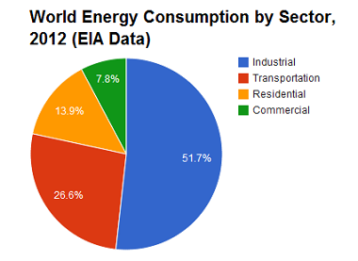
Energy Management is a Residential Problem
Energy use in the home is an important factor of total energy use
Water use is a significant portion of this problem.
US Energy Information Administration. 2012

Slide 55

Water Is Becoming Scarce
“Water scarcity is among the main problems to be faced by many societies and the World in the XXIst century.” - Human Development Report 2006, UN

Slide 56
Current Systems Fail to Maximize Usability
DoubleDip senses flow with an accelerometer
Increases energy needs
DoubleDip board is 58 cm² (9 in²)
More obtrusive installation
These problems limit usability
DoubleDip

Slide 57
DOE’s call for “open architecture sensors”
“BTO [Building Technologies Office] is developing open-architecture sensors and sensor systems that easily share data to enable building operators and owners to cost effectively capture energy and cost savings through the use of new and existing control system applications. The objective is to take to market new sensors and sensor configurations that allow easy application to building operation, easy and open access to the data from the sensors, and novel application of sensor data to building management systems. BTO is particularly interested in innovative approaches that reduce the cost and power consumption for data collection of common building operation variables (temperature, pressure, relative humidity, etc.), open-source sensor packages that allow for data acquisition and transmission with increased lifespan between manual calibrations, “virtual sensors” enabled by innovative combinations of hardware and software, and easily installed “plug and play” sensor packages in which sensors would be automatically recognized by building energy management systems, in a manner similar to how conventional printers are easily recognized by an existing computer network.”
Source(s):
“Building Energy Efficiency Frontiers and Incubator Technologies (BENEFIT),” DE-FOA-0001027, 2014
Notes:
“BTO is developing open‐architecture sensors and sensor systems that easily share data to enable building operators and owners to cost effectively capture energy and cost savings through the use of new and existing control system applications. The objective is to take to market new sensors and sensor configurations that allow easy application to building operation, easy and open access to the data from the sensors, and novel application of sensor data to building management systems. BTO is particularly interested in innovative approaches that reduce the cost and power consumption for data collection of common building operation variables (temperature, pressure, relative humidity, etc.), open‐source sensor packages that allow for data acquisition and transmission with increased lifespan between manual calibrations, "virtual sensors" enabled by innovative combinations of hardware and software, and easily installed "plug and play" sensor packages in which sensors would be automatically recognized by building energy management systems, in a manner similar to how conventional printers are easily recognized by an existing computer network.”

Slide 58

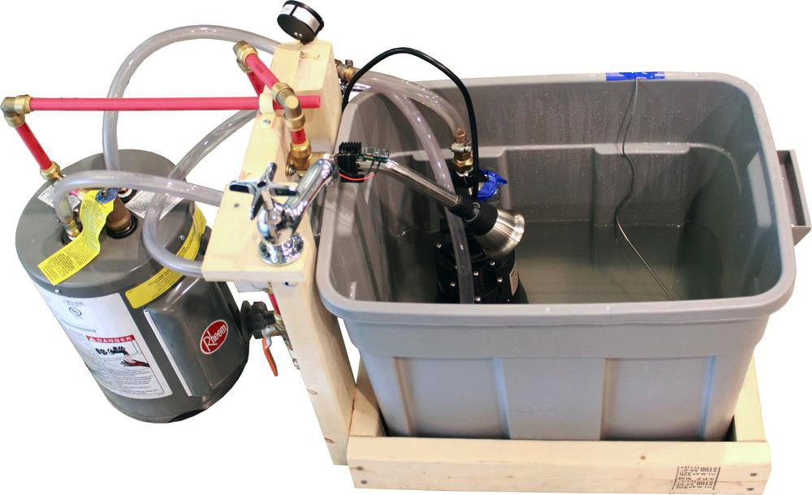
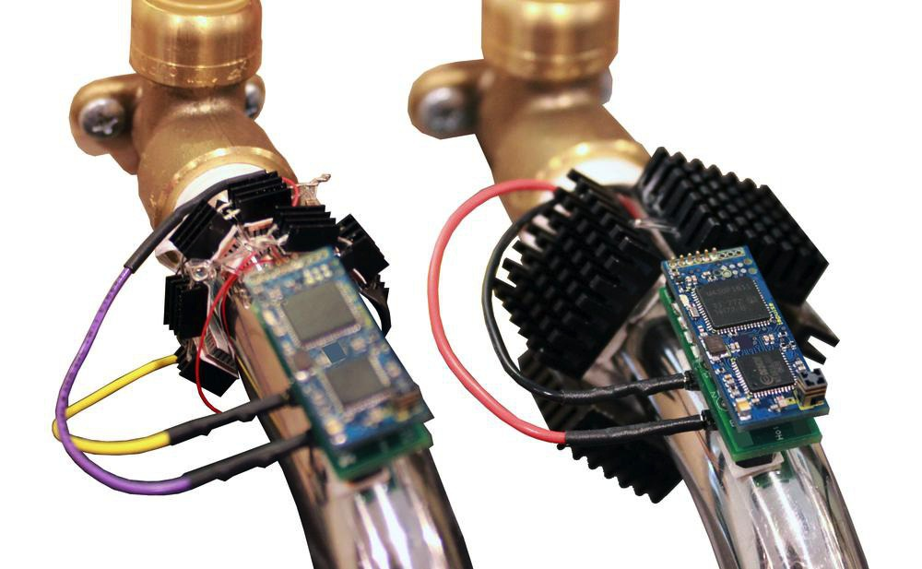
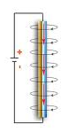
Measuring energy consuming activities
Monjolo: A Portuguese
water hammer

Slide 59
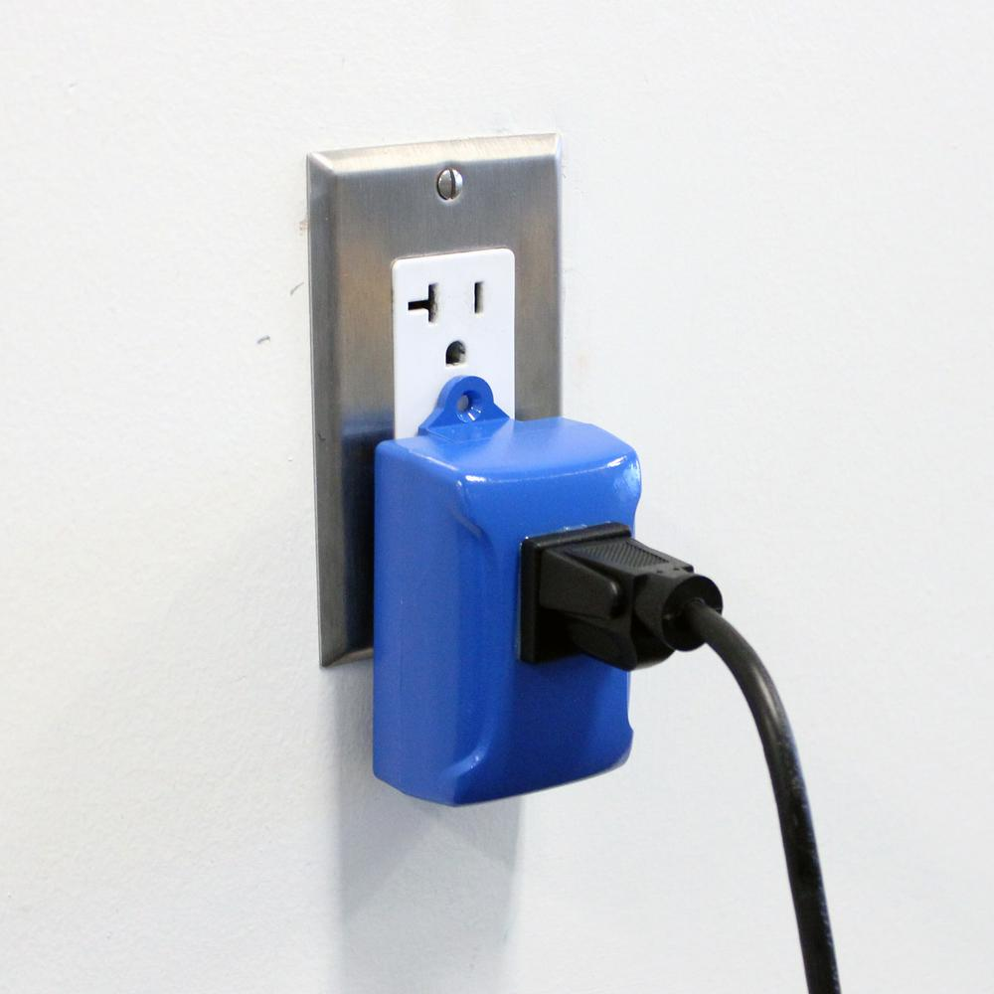
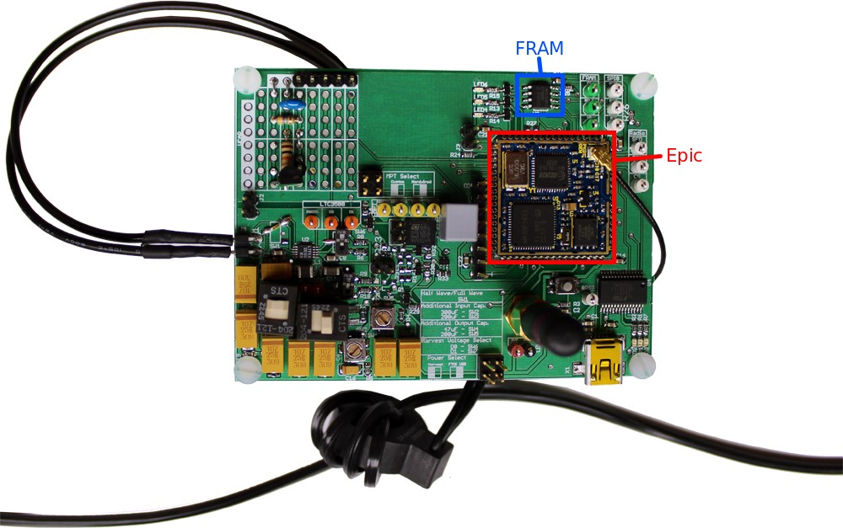
Monjolo meter realizations
Test board
Plug-load
Light-level
Panel-mount

